Slide 1
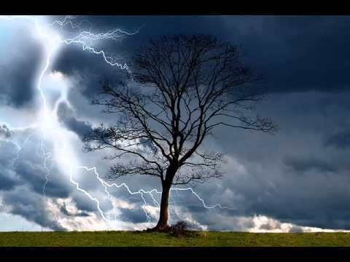
“God as father….? Yes!”
Psalm 68:5
Psalm 27
Luke 18:9-14
Matthew 6:5-15
“In His Holy Dwelling”
“The House of the Lord”
“Went home justified”
“Our Father”
There is only one universe - It’s all sacred, and it’s all revelation
Song, Sin
& the “Unseen”

Slide 2
Western culture has tended to be an extroverted culture and a “can-do” culture. Prayer too easily became an attempt to change God and aggrandize ourselves instead of what it was meant to be – an interior practice to change the one who is praying, which will always happen if we stand calmly before this uncanny and utterly safe Presence, allowing the Divine Gaze to invade and heal our unconscious, the place where 95 percent of our motivations and reactions come from. All we can really do is return the gaze. Then, as Meister Eckhart so perfectly said, “the eye with which we look back at God will be the same eye that first looked at us.” We just complete the circuit! ~Richard Rohr

Slide 3
Do not deprive the foreigner or the fatherless of justice, or take the cloak of the widow as a pledge. Remember that you were slaves in Egypt and the Lord your God redeemed you from there. That is why I command you to do this.
When you are harvesting in your field and you overlook a sheaf, do not go back to get it. Leave it for the foreigner, the fatherless and the widow, so that the Lord your God may bless you in all the work of your hands. When you beat the olives from your trees, do not go over the branches a second time. Leave what remains for the foreigner, the fatherless and the widow. When you harvest the grapes in your vineyard, do not go over the vines again. Leave what remains for the foreigner, the fatherless and the widow. Remember that you were slaves in Egypt. That is why I command you to do this. ~Deuteronomy 24:17-22

