Slide 1
“Running Well...”
Galatians 5
identity and belonging = “justification” (declaration of right)~5:4
“by works of the law” or “by the hearing of faith”
“For freedom Christ has set us free.” ~5:1
“For in Christ neither circumcision nor uncircumcision counts for anything...” ~5:6 ???!!!
5:14 / Leviticus 19:18
What shape does this take in our practical living?
“Flesh vs Spirit”
(self indulgence / other -
How we relate)

Slide 2
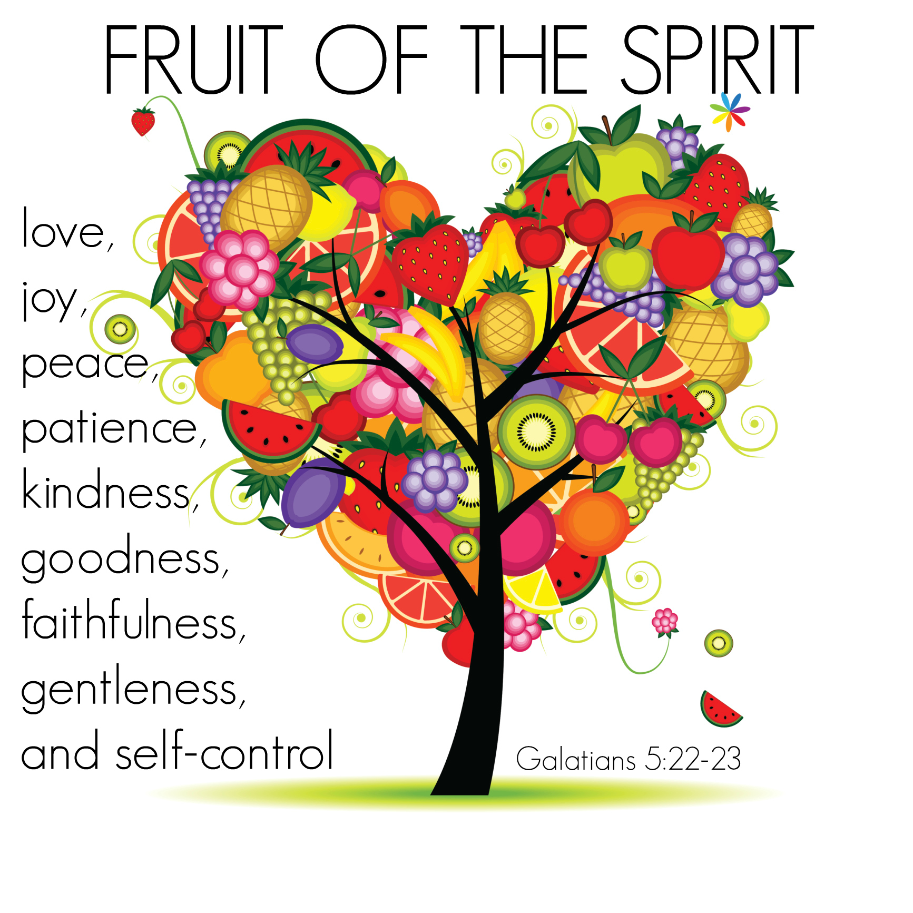
“Work out your own salvation...for it is God who is at work in you, enabling you both to will and to work for his good pleasure”.
~Phillipians 2:13
Acts (plurality) of the ‘flesh’ do not create the character and virtue we seek for our lives! (singular fruit)
“A Christian is a perfectly free lord of all, subject to none. A Christian is a perfectly dutiful servant of all, subject to all.” ~Luther

