Slide 1
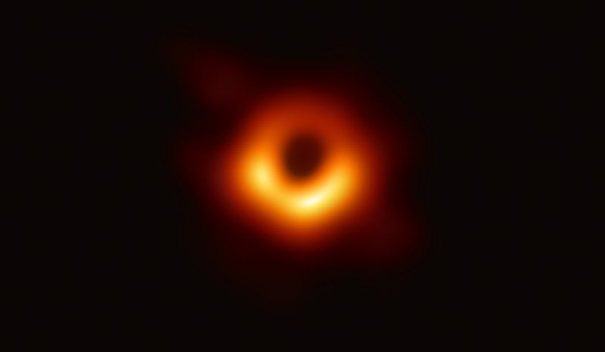
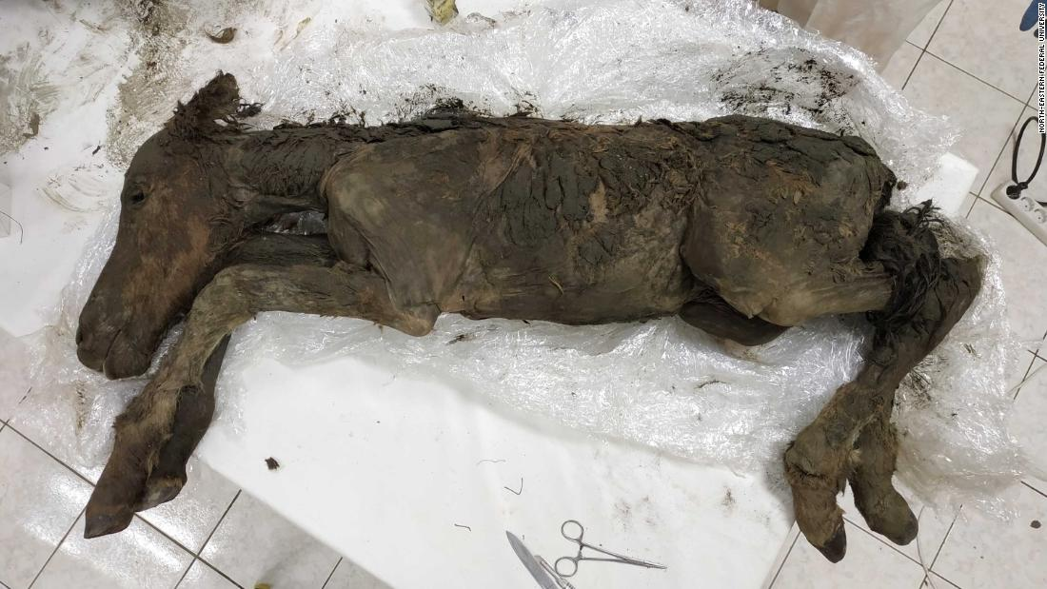
Easter 2019
“Deep Dawn: Physical, Personal, Communal”
40 days ago we began Lent with the imposition of ashes and the recitation of “remember that you are dust, and to dust you shall return” ~Gen. 3:19
Existential & Rational
Spiritual practice
Resurrection destabilizes
& creates new possibilities!
~Mark 9:10
"We have seen what we thought was un-seeable."
~Sheperd Doeleman, director Event Horizon Telescope Collaboration

Slide 2
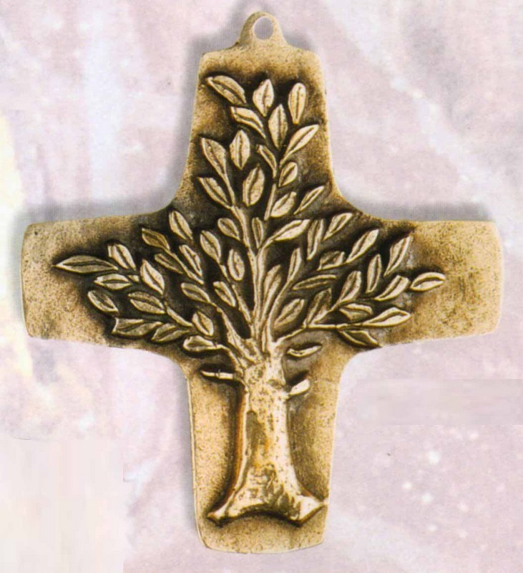
“At Easter we are really standing in the middle of a second 'Big Bang,' a tumultuous surge of divine energy as fiery and intense as the very beginning of the universe.”
~Rowan Williams, former Archbishop of Canterbury
Resurrection as physical phenomenon that vindicates the very real life & crucifixion of Jesus of Nazareth
Powers of Death do not prevail!
“Pharaoh”/Caesar/Herod/Pilate/Ciaphas – physical, political claim
Genesis 2:9 / Acts 13:29
Crucifixion as Tree of Life!
Exile & Return Pattern

Slide 3
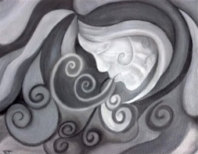
I come to the garden alone While the dew is still on the roses And the voice I hear falling on my ear The Son of God discloses. And He walks with me, and He talks with me, And He tells me I am His own; And the joy we share as we tarry there, None other has ever known. I’d stay in the garden with Him Though the night around me be falling, But He bids me go; through the voice of woe His voice to me is calling.
~Charles Austin Miles (1912)
Genesis 2:7 John 20:22
This is our hope,
our inspiration and our challenge!
“Practice Resurrection”
~Wendell Berry

Slide 4
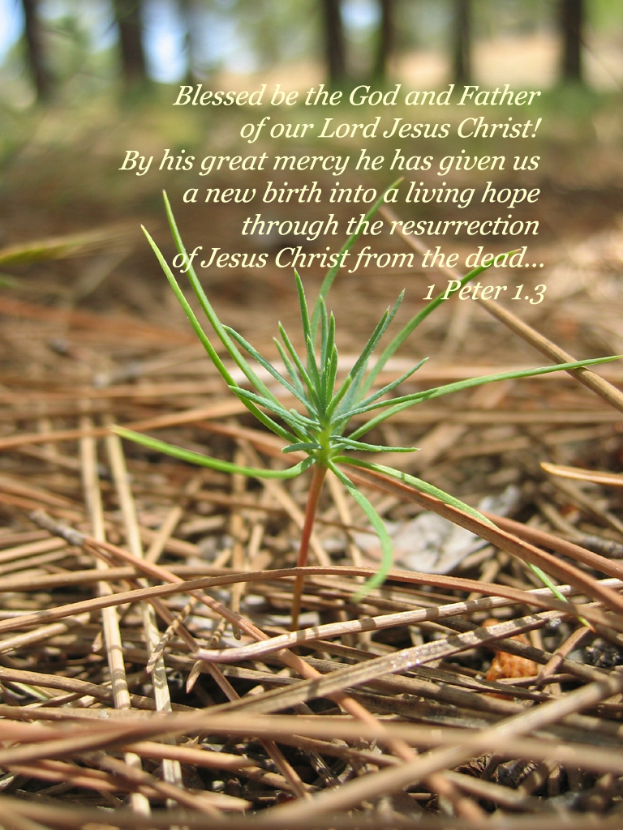
When Jesus saw his mother there, and the disciple whom he loved standing nearby, he said to her, "Woman, here is your son, and to the disciple, ‘Here is your mother.”
John 19:26-27
“She shall be called Woman” Gen 2:23
“The man called his wife’s
name Eve, because she was
the mother of all the living”
Gen 3:20
Jesus final act = changes the relationship (disciple to son) John 1:12 = possibility of newness & birth! (blood & water) Family!

